Slide 1
HEiE
Higher Education in Emergencies
Peggy Lynn MacIsaac
August 2016

Slide 2
HEiE higher education in emergencies
Overview
assumptions
legal and humanitarian frameworks
organizations for accredited higher education
hope

Slide 3
HEiE assumptions

Slide 4
Humanitarian Aid Priorities .
(Need for development, creativity).
Met through autonomy and achievement.
SELF-ACTUALIZATION
(Need for self-esteem, power, recognition, prestige)
Met through achievement, recognition, promotions and bonuses.
EGO
(Need for being loved, belonging, inclusion)
SOCIAL
(Need for safety, shelter, and stability)
SECURITY
(Need for air, water, food, exercise, rest, freedom from disease and disabilities).
PHYSICAL
(Adapted from Maslow, 1943)
Notes:
The first assumption pertains to what is important in serving refugees, internally displaced people, and asylum seekers (RIDPAs). Prioritized humanitarian responses often remain at this base level.

Slide 5
United Nations
Declaration of Human Rights
Article 26
Everyone has the right to education. Education shall be free, at least in the elementary and fundamental stages. Elementary education shall be compulsory. Technical and professional education shall be made generally available and higher education shall be equally accessible to all on the basis of merit.
(UN General Assembly
December 10, 1948)
Notes:
Education as a human right is only protected to junior high school level. Completing secondary school as a prerequisite to higher education is a significant barrier for many displaced persons.

Slide 6
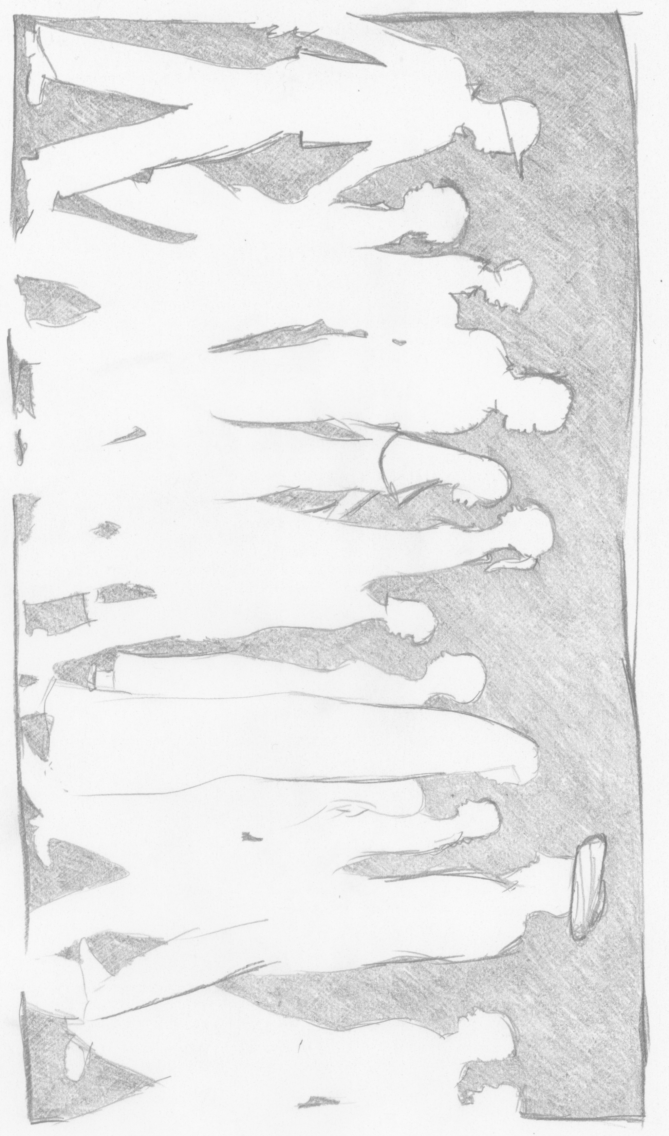
HEiE subverting the assumptions
65.3 Million People
200K - 1M potential adult learners at the tertiary level
(United Nations High Commission for Refugees, 2016)
Notes:
The United Nations High Commission for Refugees (UNHCR) is the authoritative source for estimating the populations of refugee, internally displaced persons, and asylum seekers (RIDPAs) around the world.
If these populations inhabited one country, it would be the 21th largest country in the world, 22, 23, and 24th largest would be The UK, France and Italy respectively. Canada would be #39.
(United Nations, Department of Economic and Social Affairs, Population Division, 2015).
This is a conservative estimate 200,000 (gifted) and a million potential tertiary level learners who are RIDPAs around the world.
That’s more than all the university students enrolled in Canada in one year.

Slide 7
HEiE subverting the assumptions
Education in emergencies can be both life-sustaining and life-saving. It can communicate messages about safety, life skills, and vital health and hygiene information.
(The Sphere Project, 2011, p.12)

Slide 8
HEiE priorities .
(Need for development, creativity).
Met through autonomy and achievement.
SELF-ACTUALIZATION
(Need for self-esteem, power, recognition, prestige)
Met through achievement, recognition, promotions and bonuses.
EGO
(Need for being loved, belonging, inclusion)
SOCIAL
(Need for safety, shelter, and stability)
SECURITY
(Need for air, water, food, exercise, rest, freedom from disease and disabilities).
PHYSICAL
(Adapted from Maslow, 1943)
Notes:
The priorities of higher education in emergencies has a higher need than the base level of humanitarian aid.

Slide 9
HEiE legal and humanitarian frameworks

Slide 10
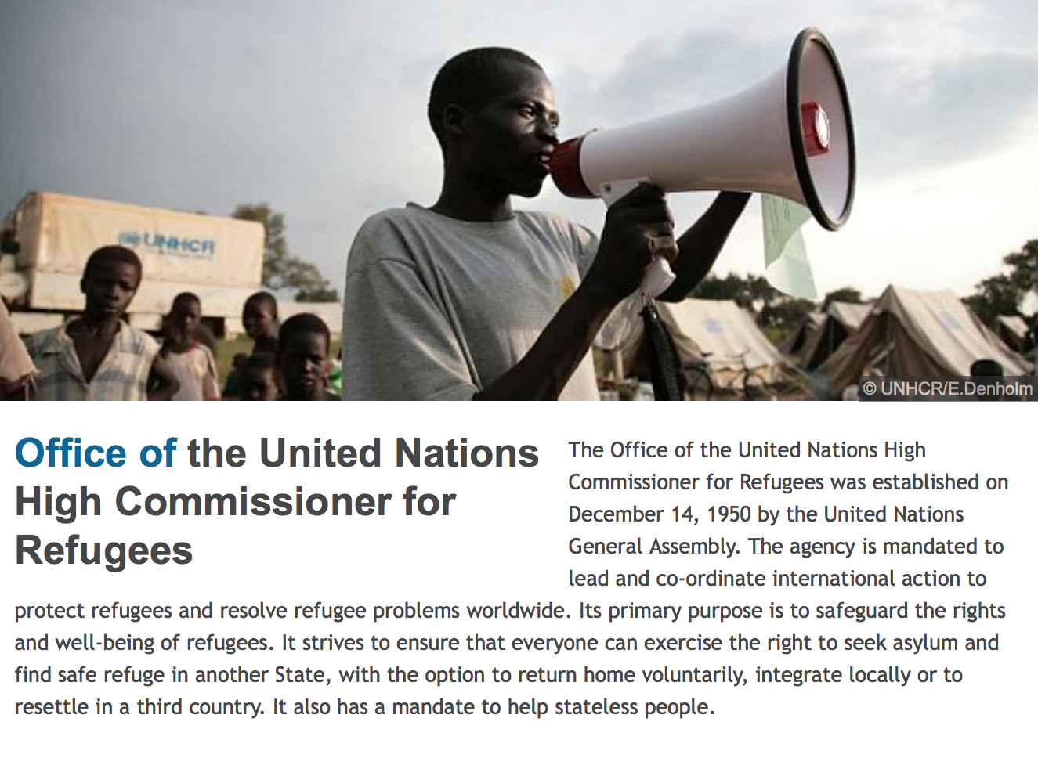
(UNHCR, 2015)
Notes:
UNHCR is the major organization is this area.

Slide 11
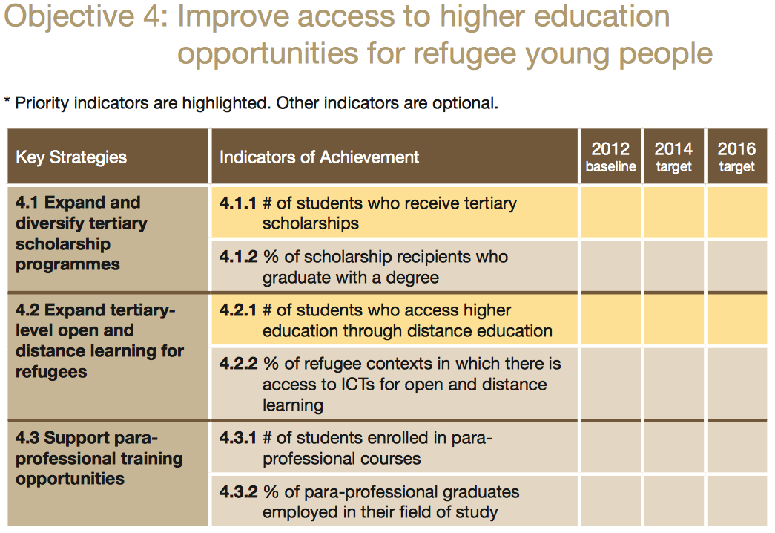
UNHCR: educational strategy
(UNHCR, 2012)
Notes:
Tertiary education is not a priority in the humanitarian response for RIDPAs.
There is a need, and the UNHCR set an objective to meet this need.
Open and distance learning are explicitly named as a key strategy.
Distance education is well suited to providing education opportunities for RIDPAs, because they can start their education when they are in their temporary location, and finish it when they are settled into their long term home, without interruption of their education.

Slide 12
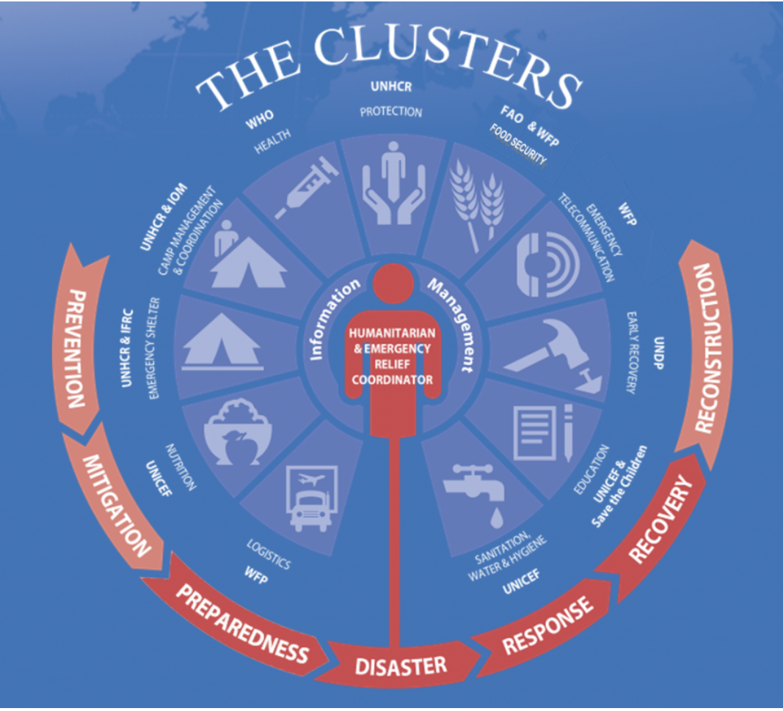
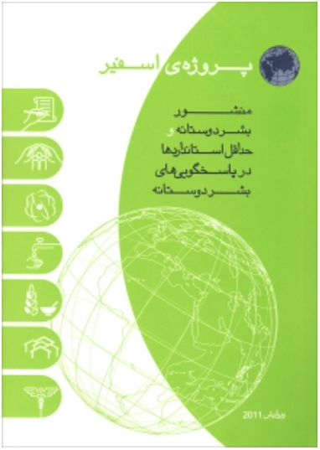
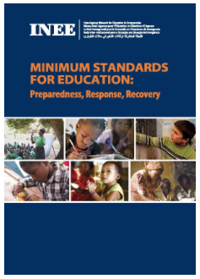
Coordination
global aid community
Sphere Handbook
Cluster Inter-Agency Coordination
INEE Minimum Standards for Education
Notes:
There are sector wide planning, coordination, and standards of humanitarian response to crisis.
Cluster Inter-Agency Coordination is through the UN Office of the Coordination of Humanitarian Affairs (OCHA) (2016)
Sphere Handbook: Humanitarian Charter and Minimum Standards in Humanitarian Response – They coordinate the translation of this into five languages (French, English, and Spanish, the working languages of Sphere and Arabic and Russian). Sphere encourages translations into other languages. The current 2011 version is free to download in 24 language. The 2010 version is in more languages including Portuguese.(Sphere Project, 2015)
INEE Minimum Standards for Education: Preparedness, Response, Recovery is a companion to the Sphere Handbook focusing on education at all levels and ages. It sets out 19 standards for ensuring quality and safe access to education. (International network for education in emergencies, 2016).

Slide 13
HEiE organizations for accredited education

Slide 14
At the forefront of accredited HEiE.
Jesuit Worldwide Learning: Higher Education at the Margins – JWL:HEM – is often the face-to-face education partner in multi-agency humanitarian efforts.
Borderless Higher Education for Refugees (BHER) – partners with
  Kenyatta University.
  Moi University.
  United Nations High Commission for Refugees (UNHCR) – fosters innovation in higher education.
  University of British Columbia.
  Windle Trust Kenya.
  York University – Centre for Refugee Studies – provides a Certificate in Educational Studies program to students in Canada and Dadaab Refuge Camp in Kenya.
InZone– training language translators in fragile contexts.

Slide 15
HEiE hope

Slide 16
Hope
When I first started researching in this area there was an estimated 49 million persons forcibly displaced around the world. Now it is 65.3 million.
My hope lays in the scalability of locally created and contextualized open and distance learning.
65.3 Million People
49 Million People

Slide 17
HEiE ways to contribute
Fragile contexts:
  Hold multiple challenges, such as the availability of time, mobility, infrastucture, prior learning, social support, and academic mentorship, for learners who don’t know how long they’ll be there.
  Do not prioritize education beyond elementary level.
  Do not have the opportunity to build brick and mortar post-secondary institutions. Even if they did the demand for colleges and universities far exceeds the human capacity to build and staff them.
  Have a brain drain as individuals are relocated once they achieve academic success. There is a constant need to train teachers to work at the primary and elementary levels.
  Have many researchers around the world wishing to “study” those living there.
Partnership between organizations streamlines some of the logistical challenges of providing higher education in fragile contexts.
International agreements on transferability of credited coursework opens the opportunities for these learners.
Locally contextualized open educational resources (OER) can strengthen learning opportunities as they build upon the intrinsic indigenous knowledge, respect the knowledge and assets the learner brings to the educational experience, and contribute to the world knowledge in the field of education.
Inspired creative disruptive innovation holds the hope for meeting the needs of potential adult learners in fragile contexts, who through distance education could start their learning in one location and finish it in another.
Notes:
Here are some concrete strategies and approaches to working in the area of higher education in emergencies.

Slide 18
HEiE references

Slide 19
References
International Network for Education in Emergencies. (2010). INEE minimum standards handbook: Preparedness, response, recovery. Retreived from http://toolkit.ineesite.org/toolkit/INEEcms/uploads/1012/INEE_GuideBook_EN_2012%20LoRes.pdf
Maslow, A. H. (1943). A theory of human motivation. Psychological Review, 50(4), 370-396.
Sphere Project. (2015). The Sphere Project / Humanitarian charter and minimum standards in humninatarian response. Retrieved from http./www.shprereporject.org.
United Nations Department of Economic and Social Affairs, Population Division. (2015). World population prospects: The 2015 revision [Excel file]. Retrieved from http://esa.un.org/unpd/wpp/DVD/
United Nations General Assembly, Universal Declaration of Human Rights, 10 December 1948, Resolution 217 A-III. Retrieved from http://www.un.org/en/universal-declaration-human-rights/

Slide 20
References
United Nations High Commission for Refugees. (2012). Education strategy 2012-2016. Retrieved from http://www.unhcr.org/5149ba349.pdf
United Nations High Commission for Refugees. (2015). About us. Retrieved from http://www.unhcr.org/pages/49c3646c2.html
United Nations High Commission for Refugees. (2016). Figures at a Glance. Retrieved from http://www.unhcr.org/figures-at-a-glance.html
United Nations Office for the Coordination of Humanitarian Affairs. (2016). Cluster Coordination. Retrieved from http://www.unocha.org/what-we-do/coordination-tools/cluster-coordination
Note: Pencil drawings are the work of Peggy Lynn MacIsaac ©2015.

