Slide 1
Two School-Based Mental Health Services: One Systemic Approach
Jeff Chang, Ph.D., R.Psych.
Associate Professor
Athabasca University
Director, the family Psychology Centre

Slide 2
Two School-Based Mental Health Services: One Systemic Approach
Acknowledgements:
Program funding provided by Alberta Health Services
  Mental Health Capacity Building Projects
  Student Health Partnership
Athabasca University
  Academic and Professional Development Fund

Slide 3
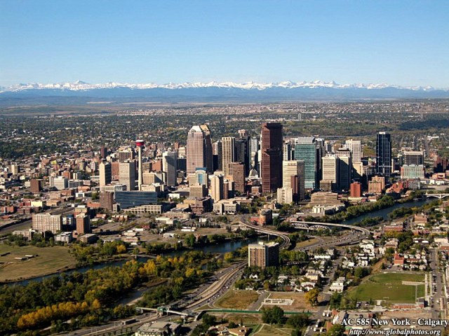
The Context: Calgary, AB, Canada

Slide 4

Calgary, AB

Slide 5

Calgary, AB

Slide 6

Calgary, AB

Slide 7
Foundations
Ecosystemic theory
  Microsystem, mesosystem, exosystem, and macrosystem
Resilience literature
  Relationships, connections, having a confidante
  Skills/interests
  Values
Family therapy (Kenneth Hardy)
  Context
  Relationships
  Interactions

Slide 8
The InterSSCT (“intersect”) Model
Interfaces
Systems
Skills
Connections
Transitions

Slide 9
The InterSSCT (“intersect”) Model
A heuristic for guiding program development
A template for reflective practice
A framework for case conceptualization

Slide 10
Two School-Based Mental Health Services
Family-School-System Consultation Service (Student Health Partnership) – mental health therapists providing a targeted larger systems consultation service
Wellness Empowerment Program (Mental Health Capacity Building Projects) – universal in-school mental health programming

Slide 11
Family-School-System Consultation Service
Referral criteria:
Students from Grades 1 to 12 in any independent school experiencing emotional-behavioral problems, and who have exhausted the resources of their school. Referrals are accepted from the school in which the student is registered.
Purpose:
To facilitate planning, support, and implementation, to maximize school success for the student, and system responsiveness to the family.

Slide 12
Family-School-System Consultation Service
What happens at the Consultation Meeting?
The Mental Health Consultant conducts a larger systems interview to:
obtain their view of the problem
clarify goals
list attempted solutions
learn what additional supports or services would be considered helpful by the partners

Slide 13
Family-School-System Consultation Service
ascertain what additional information (diagnosis or assessment) would be useful to the partners
make a plan, clearly specifying the contributions of the school, parents, student, FPC, and other service providers

Slide 14
Family-School-System Consultation Service
The following services are available from Family School-System Consultation:
follow-up Consultation Meetings
short-term individual support to the student
consultation to the school
outcome-oriented, focused counselling for children and/or families

Slide 15
Family-School-System Consultation Service
referral to speech-language therapy and/or occupational therapy
facilitation of access to medical/pediatric/psychiatric consultation services

Slide 16
Family-School-System Consultation Service
Case conceptualization
Interfaces:
Ensure that relationships between the service and the schools are clear and that the mandate of the service is well understood
Are the interfaces between the school and community agencies functional?
What is quality of the interactions between the school and the family? Do they agree about how to construct the problem?

Slide 17
Family-School-System Consultation Service
Systems
What are the formal rules (policy and procedures) of systems (school division, mental health, child protection)?
What are the informal rules of the system (organizational culture) of the school and the family?
Skills
What are the proactive and prosocial skills of the various individuals in the system?
Are there skill deficits?
What is the readiness for change?

Slide 18
Family-School-System Consultation Service
Connections
What are the positive relationships in the system?
Can existing connections support the interventions (stages of change/working alliance)
What relationships need to be built up and enhanced?
Transitions
How do the school and family handle within-day, day-to-day and week-to-week transitions?
How do they manage the rhythm of the school year?
How do they manage Family Life Cycle and developmental transitions?

Slide 19
Universal Mental Health Programming in Schools
On one hand, health, including mental health is not the core business of schools, with the exception of legislated mandates related to identified students with disabilities.
On the other hand, the whole school mental health literature notes:
  schools are the only point of close-to universal access to young people
  young people spend close to half their waking hours in school

Slide 20
Universal Mental Health Programming in Schools
  the quality of experiences with teachers and peers affect emotional wellbeing
  transitions in education are significant events in the lives of younger adolescents. The transition from primary school to secondary school brings a loss of continuity in relationships (teachers and peers).
  Schools provide an entry point to the family

Slide 21
Universal Mental Health Programming in Schools
Exemplary whole school programs: MindMatters and Gatehouse Program (Australia)
The latter uses attachment theory as a conceptual framework: “The extent to which an individual has robust social ties is likely to have a direct influence on self-concept and sense of belonging, and, in turn, reactions to social stressors.”

Slide 22
Universal Mental Health Programming in Schools
  Whole school programming:
  Avoids piecemeal ‘add-ons.’ Many school-based interventions take a single-issue focus with short-lived support.
  These are perceived as extras and remain in fragmented pockets in the school.
  such health initiatives are perceived as increasing the workload and stress of teachers.

Slide 23
Universal Mental Health Programming in Schools
  supports sustainable and institutionalized practices
  Three school functions, structures and culture:
    school social and learning environments
      Whole school
      Classroom
    content and implementation of school curriculum
    the linkage between the school and its community.

Slide 24
Universal Mental Health Programming in Schools
  Although direct counselling services are part of universal programming, they are de-emphasized.

Slide 25
The Wellness Empowerment Program
A universal mental health program for two schools serving Muslim students in Calgary
70,000-strong Muslim community in Calgary
Funded by Alberta Health Services Mental Health Capacity Building fund

Slide 26

The Wellness Empowerment Program
A publicly funded, ESL charter school
Elementary and Middle School Campus with about 650 students

Slide 27

The Wellness Empowerment Program
Calgary Islamic School: Private religious school
K-12 on one campus (650 kids)

Slide 28
Interfaces
“Points of connection between systems”
As a service provider, our first point of connection was to make sure we knew what the schools wanted and need
  Undertook a one year development process using ideas from Appreciative Inquiry
Collaborating with the Muslim Council of Calgary

Slide 29
Interfaces
Linking the schools with:
  Child protection authorities
  Alcohol and drug treatment agency (for information sessions)
  Other schools
  Calgary Police Service

Slide 30
Interfaces
  Health care system
  Domestic violence services
Connecting children with Islamically appropriate recreational opportunities
What other interfaces to we need to strengthen?

Slide 31
Systems
“Understanding and fitting in with the mandate, rules, and communication style of systems you are serving”
“Acting as a bridge between systems to ensure they interface properly”
One the interface is built, it needs to be serviced

Slide 32
Systems
A Grade 3 girl, who had not spoken in school since ECS, was referred to the WEP team. We supported a referral to a specialized clinic at Alberta Children’s Hospital, where a clinical psychologist devised a behavioral shaping program to reinforce the girl for speaking in tiny increments. The worker supported the mother, the teacher, and the child to implement the program over the school year, with at least 83 contacts with the girl, who is still quiet, but has given oral presentation to her class.

Slide 33
Systems
“Thank you for helping me with doctor’s appointments. It’s good to know that this type of support is in the school.”
-Parent

Slide 34
Skills
“Supporting skills and competencies for all members of the school community”
A combination of skills geared to “mental health issues” and life in general
Resiliency literature supports to idea that when people are more competent across domains, they are more protected from poor mental health outcomes
Connections
“Ensuring that everyone has a place to go in a safe and caring school”

Slide 35
Supporting Skills and Connections
Activities:
Whole-school activities (e.g., Wellness Day)
Parent activities (e.g., parenting workshops, internet safety)
Whole-class activities (presentations on organizational skills, dealing with emotions, bullying)
Targeted group activities (shyness group, girls’ group)
Specific supportive counselling to identified students

Slide 36
Example: Weekly Lunchtime Skill-Building Groups
Boys Group
Leadership
Anger Management
Girls Group
Relational Aggression
Shyness

Slide 37
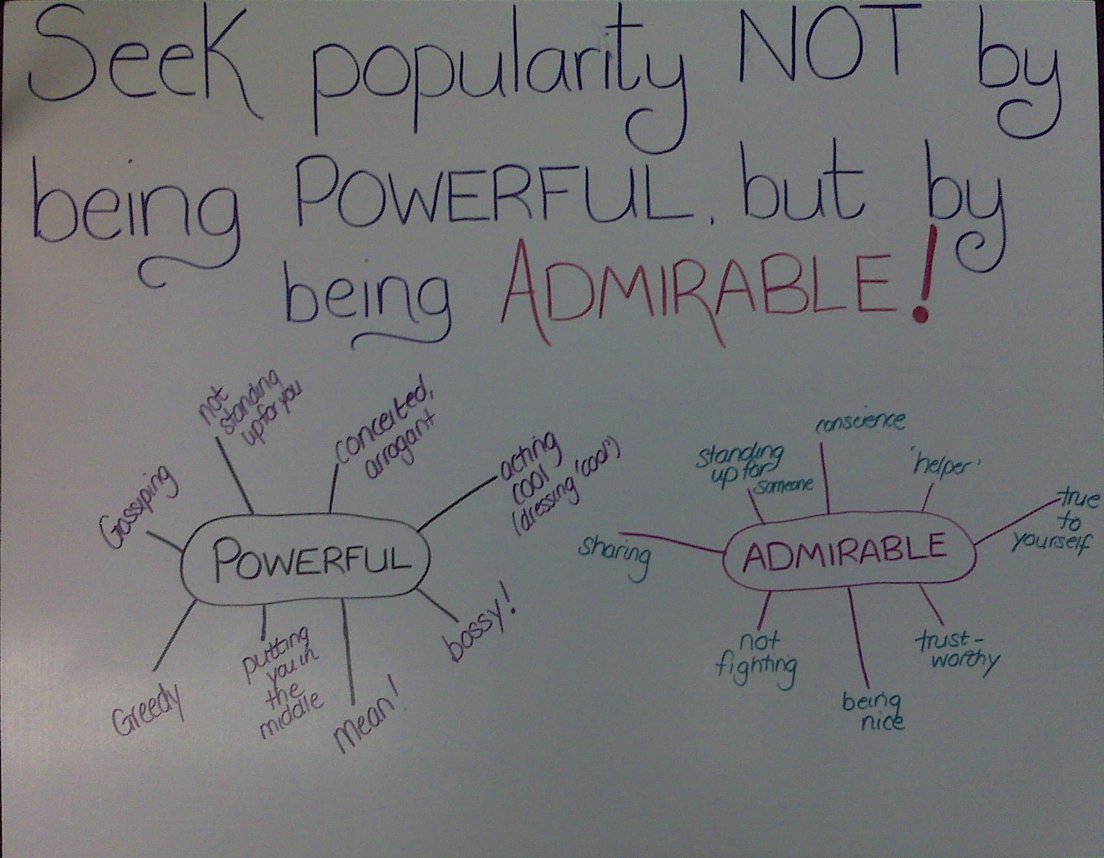
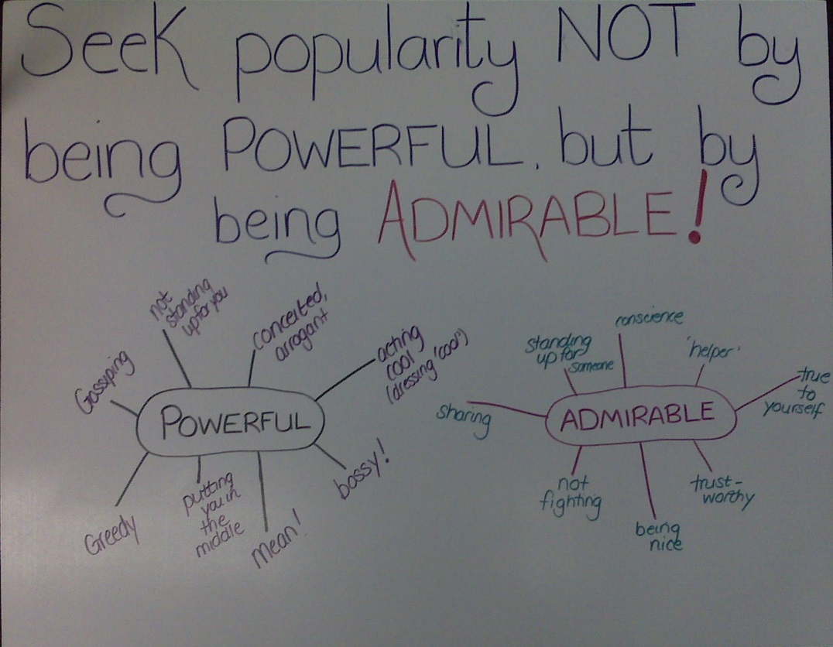
- A discussion poster from the Relational Aggression group

Slide 38
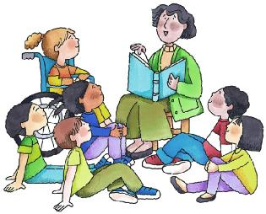
Small Group Skill Building
64 students have participated in weekly lunch-time skill building groups across 3 schools
“ This group really helped me a lot
and gave me lots of ideas and tips…”
- Student
“I liked how group is not taught in a text book-ish way - it's done in a fun way.”
-Student

Slide 39
Classroom Presentations
Over 35 different topics:
  peer relationships
  safety
  academic skills
  personal development
  problem-solving
  bullying and respectful relationships
  multiple intelligences
  emotional regulation
  Etc., etc., etc.

Slide 40
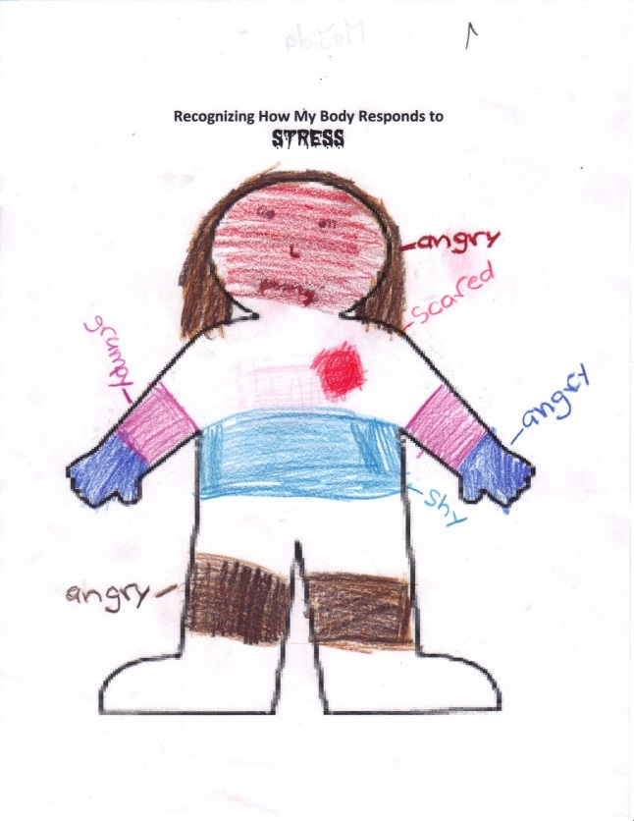

Slide 41
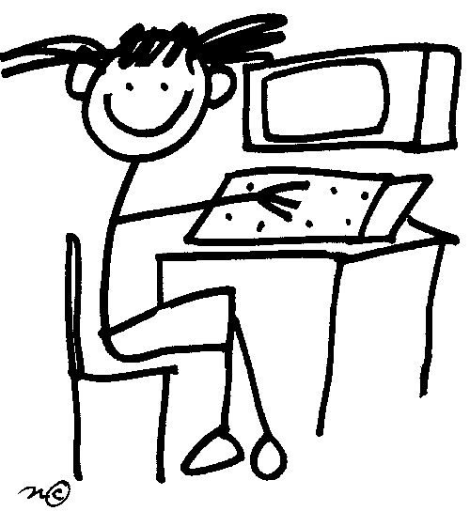
“I never knew what cyber bullying was until your presentation. It has been going on for 1 year now and I need help.”
- Gr. 6 student

Slide 42
Kindergarten-Junior High Leadership Program
Grades 6, 7 and 9 students volunteer for 6 week blocks to provide leadership activities for Kindergarten students during recess.
  Initially, in October 2008, 4 leaders
  From September ’09- Jan ‘10, 64 leaders
Teachers report that playground problems have decreased
Positive relationships between Kindergarten and Junior High students
Leaders demonstrate increased maturity and responsibility outside of volunteering time

Slide 43
Case Example: The Re-Connect Booth
Grade 5 students did not seem to have the necessary conflict resolution skills
Students were going to either their homeroom teacher or the School Support Counsellor to have their disagreements, miscommunication and misunderstanding "solved“
To teach the students how to use the booth, which was set up in a corner of the classroom, the School Support Counsellor delivered a presentation to the class on basic communications skills: The acronym is C.A.R.E.

Slide 44
Case Example: The Re-Connect Booth
  C=Conflict is happening, address it!
  A= Active Listening . Students meet together at the booth and practice active listening skills
  R = Reflect and Make a Plan. Brainstorm 3 possible solutions to the problem, and agree on which solution they would like to try first).
  E = Evaluate. 2-3 days later
Children have been actively using the booth as a location to deal with day to day social difficulties

Slide 45
Environmental/Leadership Program
Nineteen Grade 9 and 10 students:
  Green initiatives
  Service at school events
  First aid and CPR training
  Outdoor pursuits
  Peer conflict resolution
  Encouraged by Imam

Slide 46
Transitions
“Navigating typical and unexpected changes in schools, physical environment, and relationships
Requested by schools at start of project
Supporting student transitions...
    Into ECS
    ECS to Grade 1
    Grade 5 to Grade 6
    Grade 9 to High School

Slide 47
Annual Transition Activities
Half-day Grade One and Grade 6 orientations for ECS and Grade 5 students
“Thanks again, the orientation was a wonderful idea and must become an annual event. I just wish I could have thought of it!”
-Teacher
“It was extremely positive and reassuring. They are excited to go into grade six!”
-Teacher

Slide 48
Grade 6 orientation…
“I wish we had this when I was going into grade 6. We were just thrown into junior high and figured it out ourselves!”
–Student
“This is so cool! I’m so glad I know how to open my lock and read my timetable before I get to the junior high. It’s not that scary anymore.”
-Student

Slide 49
School Bus Program
Initial driver comments: “This program will never work, nothing will change.”
  Now….
“I have some of the best kids on the bus!”
“Getting better!”
“Lots of changes…
  Significant improvement in driver retention

Slide 50
“When I grow up, I want to be a School Counsellor just like the one in our school, so that I can help kids with their problems.”
-Student’s writing in the year book
Notes:
Kids always get the last word, don’t they?

Slide 51
Conclusion
Whole school or universal mental health programming has the potential to change the culture of a school
Counsellors can maximize their influence
Very little ‘counselling” may be done, but counsellors have a key role in developing and leading programming.
Whole school mental health programming sets the stage for effective therapy, when it is needed.
Cross-cultural service delivery requires more than just learning about “the other.” It requires attention to the world view of the community and appreciation of one’s own culture and privilege.

