Slide 1



Tutors
The Networked Future of Athabasca University Pedagogy
Terry Anderson, PhD and Professor

Slide 2
Overview
Technological Determinism in Distance Education
Generations of Distance Education Pedagogy
What do our students say about new technologies and learning activities?
A Networked future for Tutors at AU

Slide 3
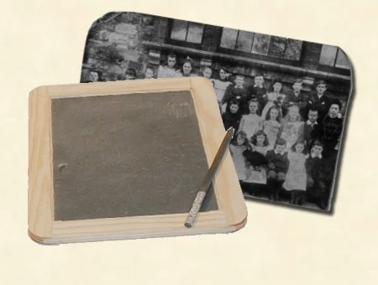
Students today can’t prepare bark to calculate their problems. They depend on their slates which are more expensive. What will they do when their slate is dropped and it breaks? They will be unable to write!”
Teachers Conference, 1703
    From Thornburg, David. (1992) Edutrends 2010: Restructuring, Technology, and the Future of Education

Slide 4
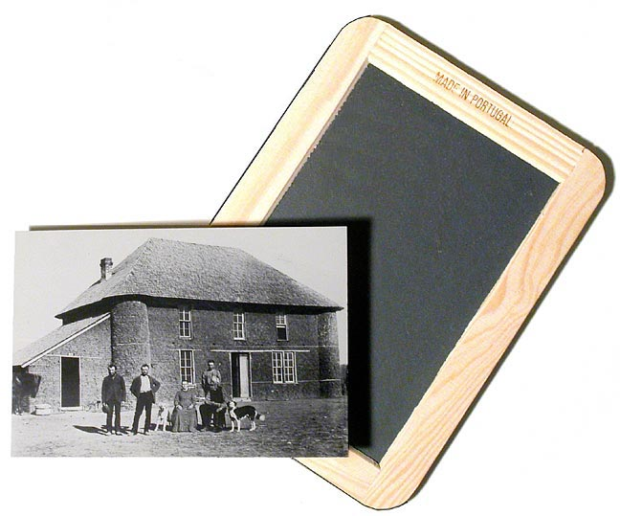
Students today depend upon paper too much. They don’t know how to write on slate without chalk dust all over themselves. They can’t clean a slate properly. What will they do when they run out of paper?”
Principal’s Association, 1815
    From Thornburg, David. (1992) Edutrends 2010: Restructuring, Technology, and the Future of Education

Slide 5
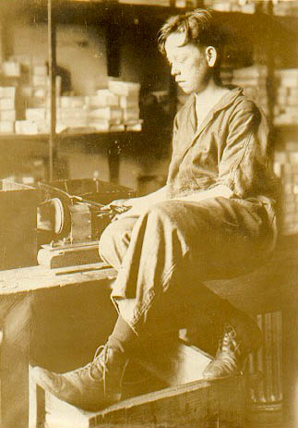
Students today depend too much upon ink. They don’t know how to use a pen knife to sharpen a pencil. Pen and ink will never replace the pencil.”
National Association of Teachers, 1907
    From Thornburg, David. (1992) Edutrends 2010: Restructuring, Technology, and the Future of Education

Slide 6
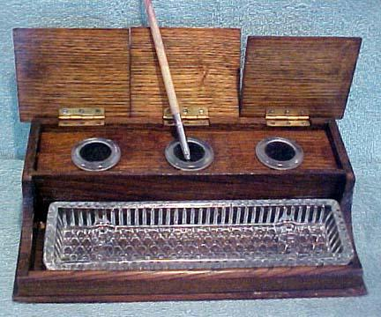

Students today depend upon store-bought ink. They don’t know how to make their own. When they run out of ink they will be unable to write. This is a sad commentary on modern education.”
The Rural American Teacher, 1929
    From Thornburg, David. (1992) Edutrends 2010: Restructuring, Technology, and the Future of Education

Slide 7
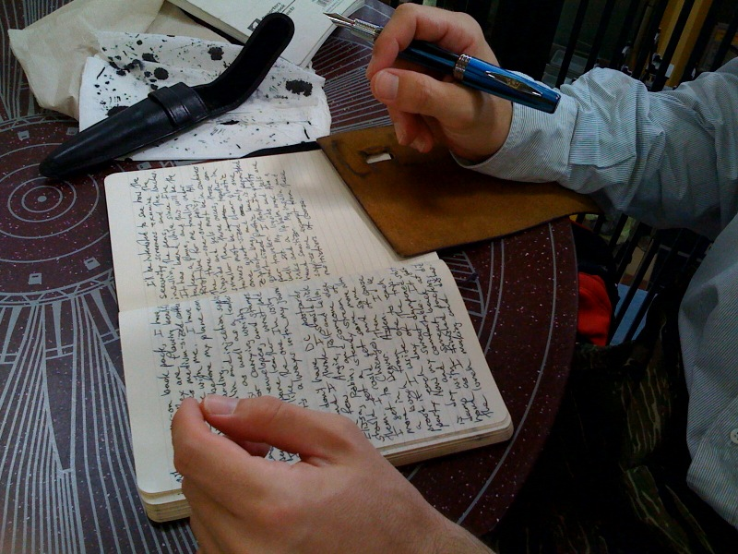
Students today depend upon these expensive fountain pens. They can no longer write with a straight pen and nib (not to mention sharpening their own quills).
We parents must not allow them to wallow in such luxury to the detriment of learning how to cope in the real business world, which is not so extravagant.”
PTA Gazette, 1941
    From Thornburg, David. (1992) Edutrends 2010: Restructuring, Technology, and the Future of Education

Slide 8

Ball point pens will be the ruin of education in our country. Students use these devices and then throw them away. The American virtues of thrift and frugality are being discarded. Business and banks will never allow such expensive luxuries.”
Federal Teacher, 1950
    From Thornburg, David. (1992) Edutrends 2010: Restructuring, Technology, and the Future of Education

Slide 9

Social Construction of Technology
Distance Education is, by definition, technologically mediated and thus is influenced by technological determinism.
BUT….
Interpretative Flexibility
  each technological artifact has different meanings and interpretations
Relevant Social Groups
  many subgroups can be delineated
Design Flexibility
  A design is only a single point in the large field of technical possibilities
Problems and Conflicts
  Different interpretations often give rise to conflicts between criteria that are hard to resolve technologically
    (Wikipedia, Sept, 2009)

Slide 10
Three Generations of Distance Education Pedagogies
Behaviourist/Cognative – AU Self Paced, Undergrad programming
Constructivist – AU Grad Programs
Connectivist – AU Future??

Slide 11

Behavioural/Cognitive Pedagogies
“tell ‘em what you’re gonna tell ‘em,
tell ‘em
then tell ‘em what you told ‘em”

Slide 12

Gagne’s Events of Instruction (1965)
Gain learners' attention
Inform learner of objectives
Stimulate recall of previous information
Present stimulus material
Provide learner guidance
Elicit performance
Provide Feedback
Assess performance
Enhance transfer opportunities

Slide 13

Enhanced by the “cognitive revolution”
Chunking
Cognitive Load
Working Memory
Multiple Representations
Split-attention effect
Variability Effect
Multi-media effect
  (Sorden, 2005)

Slide 14

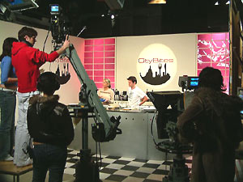
Behaviourist/Cognitive technologies
Content is king

Slide 15




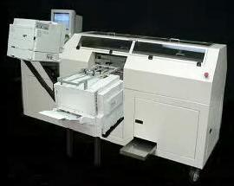
The End of Content Scarcity
Massive Global decrease in costs, complexity and collaboration,
Massive Increase in convenience and access

Slide 16
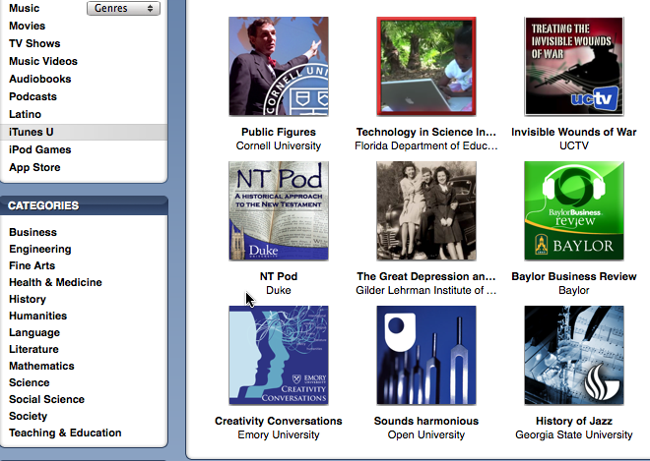
New Content Providers - ITune U
“iTunes is not simply a repository of more than 8 million songs, audio books, videos and 70,000 or so iPhone applications.
It also has the world's largest, constantly available, free educational resource” — iTunesU.

Slide 17
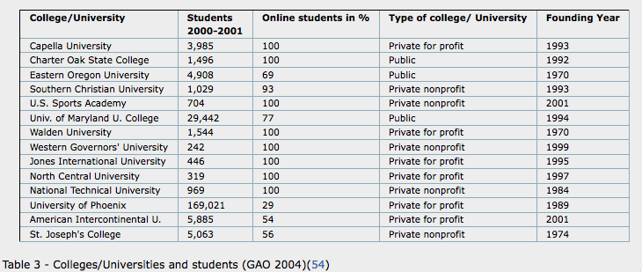
New Competitors
“The teaching staff mainly consists of hired part-time lecturers
who are still at the very entrance level to an academic career.”
eLearning in the USA: The Standard? The Benchmark? Rolf Schulmeister 2004

Slide 18


Slide 19

Value of Good Canned content
“The Great Courses” - $69-$199 (Canadian)

Slide 20
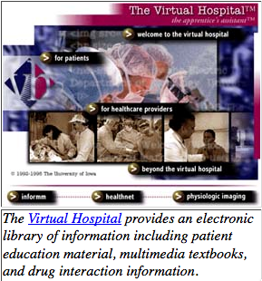
New Information Competitors
Publishers as full meal deal providers
  Web sites; mobile quizzes, audio and video podcasts, interviews, online and mobile versions, Powerpoint slides, testing
Professional & Academic
  full service web sites

Slide 21
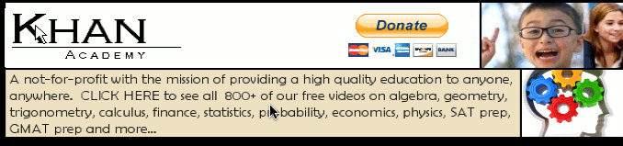
Individuals as free tutors
http://www.khanacademy.org/
See calculus derivatives: http://www.youtube.com/watch?v=rAof9Ld5sOg

Slide 22
Who Succeeds at Independent Study
Swedish study of flexible and open enrollment students:
“The result shows that the most important predictors of academic success in the course is an achievement-oriented approach to learning. The second most important predictor is expectation of the learning process as an individual activity”
  Ollssun, 2007

Slide 23


Slide 24
Pedagogical end of the line??
“programs that affect daily teaching practices and students interactions have more promise that those emphasizing textbooks or technology alone." Slavin, Lake & Groff, 2009 p. 839
Steve Lohr states: "Until fairly recently, online education amounted to little more than electronic versions of the old-line correspondence courses. That has really changed with arrival of Web-based video, instant messaging and collaboration tools.” New York Times Sept. 2009

Slide 25
2. Constructivist Pedagogy of
Distance Education
new knowledge is built upon the foundation of previous learning,
the importance of context
Errors, contradictions useful
learning as an active rather than passive process,
The importance of language and other social tools in constructing knowledge
Focus on meta-cognition and evaluation as a means to develop learners capacity to assess their own learning
learning environment should be learner-centered
the importance of multiple perspectives - groups
Need for knowledge to be subject to social discussion, validation and application in real world contexts
  (from (Honebein, 1996; Jonassen, 1991; Kanuka & Anderson, 1999)

Slide 26
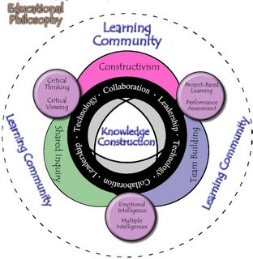
2. Constructivist Pedagogy of Distance Education
Image from Constructivism in the library

Slide 27
Where does Effective learning Happen?
“learning as located in the contexts and relationships, rather than merely in the minds of individuals”
  Greenhow, Robelia, & Hughes, (2009)
The Context of the our age is online

Slide 28
Assessing students using Constructivist Learning
What is important is the process of knowledge acquisition, not any product or observable behavior. Jonassen, 1991

Slide 29
Constructivist DE at Athabasca
Almost all of the graduate programs
Moodle designed for teacher centered, constructivist teaching/learning
Little presence beyond the course level
Problems with scalability

Slide 30
Constructivist Evaluation
the frequency with which students participate in activities that represent effective educational practice, is a meaningful proxy for collegiate quality and, therefore, by extension, quality of education.
What are effective practices?
  Level of academic challenge
  Active and collaborative learning
  Student-faculty interaction ??
  Enriching educational experiences
  Supportive social interaction. (National Survey of Student Engagement, 2003)

Slide 31
Why Groups?
Students who learn in small groups generally demonstrate greater academic achievement, express more favorable attitudes toward learning, and persist …
small-group learning may have particularly large effects on the academic achievement of members of underrepresented groups and the learning-related attitudes of women and preservice teachers. Springer, L., Stanne, M., & Donovan, S. (1999) P.42

Slide 32
Impact (Mean effect size) of Cooperative versus Individualistic Learning contexts
Dependent Variable
Achievement | .64 -88
Interpersonal Attraction | .67-82
Social Support | .62-.83
Self-esteem | .58- .67
Time on task | .76
Attitudes towards task | .57
Quality of reasoning | .93
Perspective taking | .61
From Johnson and Johnson (1989). Cooperation and competition. Theory and research

Slide 33
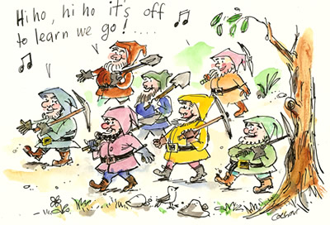
Cohort Communities of Practice
Wengler’s ideas of Community of Practice
  mutual engagement – synchronous and notification tools
  joint enterprise – collaborative projects
  a shared repertoire – common tools, LMS, IM and doc sharing

Slide 34
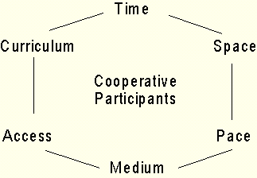
Problems with Groups
Restrictions in time, space, pace, & relationship - NOT OPEN
Often overly confined by leader expectation and institutional curriculum control
Usually Isolated from the authentic world of practice
“low tolerance of internal difference, sexist and ethicized regulation, high demand for obedience to its norms and exclusionary practices.” Cousin & Deepwell 2005
“Pathological politeness” and fear of debate
Group think (Baron, 2005)
Poor preparation for Lifelong Learning beyond the course
Relationships
Paulsen (1993)
Law of Cooperative Freedom

Slide 35
Groups are necessary, but not sufficient for advanced forms of learning.

Slide 36

Third DE Pedagogy based on Connectivist Pedagogy
Learning is building networks of information, contacts and resources that are applied to real problems.

Slide 37
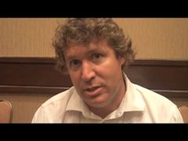
Eight core principles of Connectivism:
Siemens (2004)
Learning and knowledge rests in diversity of opinions.
Learning is a process of connecting specialized nodes or information sources.
Learning may reside in non-human appliances.
Capacity to know more is more critical than what is currently known.
Nurturing and maintaining connections is needed to facilitate continual learning.
Ability to see connections between fields, ideas, and concepts is a core skill.
Currency (accurate, up-to-date knowledge) is the intent of all connectivist learning activities.
Decision-making is itself a learning process.

Slide 38
Group
Network
Shared interest/practice
Fluid membership
Friends of friends
Reputation and altruism driven
Emergent norms, structures
Activity ebbs and flows
Rarely F2F
Metaphor: Virtual Community of Practice

Slide 39

Networks Add diversity to learning
“People who live in the intersection of social worlds are at higher risk of having good ideas” Burt, 2005, p. 90

Slide 40
Communities of Practice
Networks
Distributed
Share common interest
Self organizing
Open
No expectation of meeting or even knowing all members of the Network
Little expectation of reciprocity
Contribute for social capital, altruism and a sense of improving the world/practice through contribution
(Brown and Duguid, 2001)

Slide 41

"the network contains within it antagonistic clusterings, divergent sub-topologies, rogue nodes" Galloway and Thacker, 2007 p. 34
“There is crack in everything, that's how the light gets in” Leonard Cohen
Image from http://www.flickr.com/photos/eeblet/423397690/

Slide 42
Connectivist Learning as Trace Mining
We leave traces as we learn and use the Net
How can we use these traces to improve learning?
Can the crowd learn to teach? (Dron & Anderson, 2009)

Slide 43
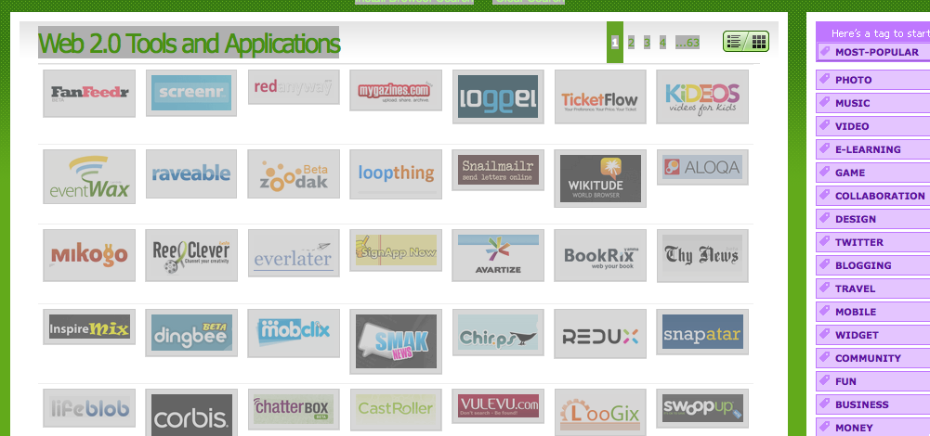
Connectivist Tools
http://www.go2web20.net/

Slide 44
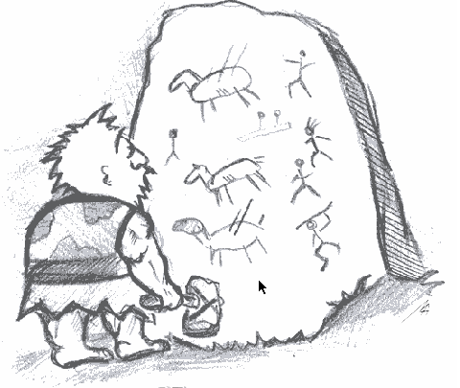
Web 2.0 is the new Literacy
Kress (2000) literacy is “socially made forms of representing and communicating” p. 157

Slide 45
Connectivist Technology
Pilot Project Examples at AU
Elgg - Me2U.athabasca.ca – Social networking
Easy M-Cast (Podcast, videocasts, screen casts)
Tutor “office hours” & recorded via Elluminate
  Tilly Jensen
Athabasca presence in immersive worlds ie Second Life – School of Business
AU on FaceBook
AU on RateMyProfessor
Media Lab at AU - Communications
New Pedagogical Model for AU courses – see Learning Design (EMD)

Slide 46
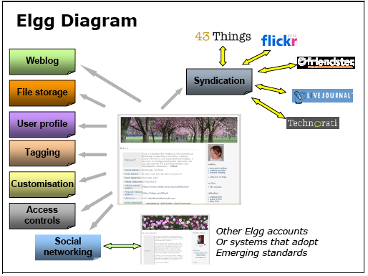
Network Tool Set (example)
Text
Text
Stepanyan, Mather & Payne, 2007

Slide 47
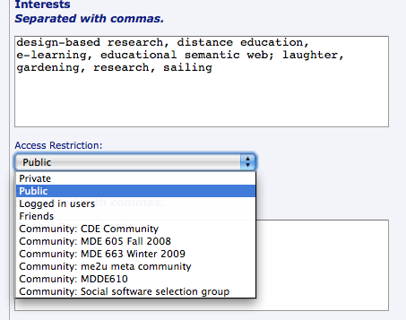
Access Controls in Elgg

Slide 48
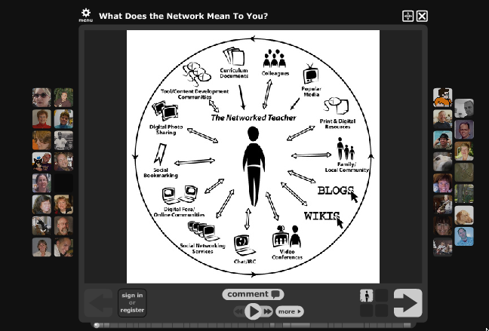
Voicethread.com

Slide 49
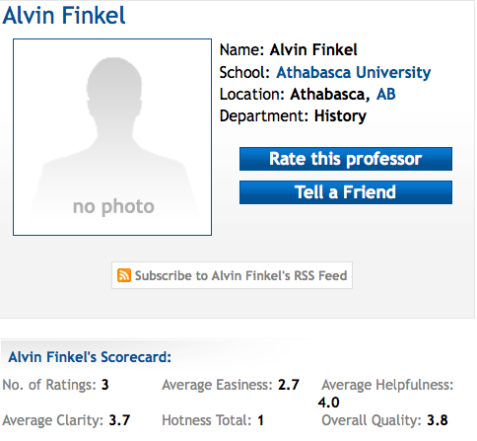
Rate My Professor

Slide 50

University of the People 2009
Tuition Free Education?
Using the power of peer learning and cooperation

Slide 51

What do are our students really need and want??

Slide 52
Survey Results –Anderson et al 2004
  78% indicated they would interact with other students if they were also able to proceed through the course at their own pace.

Slide 53
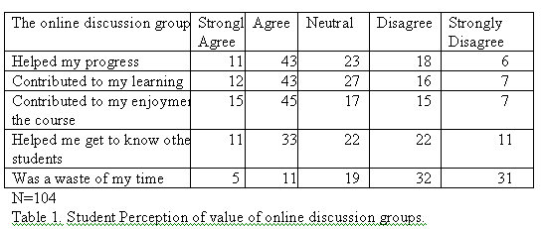
Survey Results Anderson et al 2004
Only 29% of the student respondents had participated in the optional (credit and non credit) interactive computer conferences

Slide 54
Undergrad Survey Sept. 2009
N=820
Draft Results AU Unpaced Learners social Software Survey, Anderson Sept 2009 sent to 3763 undergrad students who enrolled in AU ungrad courses in Aug.2009 24.7% response rate

Slide 55
Draft Results, AU Unpaced Learners Social Software Survey, Anderson Sept 2009

Slide 56
Draft Results, AU Unpaced Learners Social Software Survey, Anderson Sept 2009

Slide 57
Draft Results, AU Unpaced Learners Social Software Survey, Anderson Sept 2009
Notes:
Can you change this to % of valid replies.

Slide 58
Draft Results, AU Unpaced Learners Social Software Survey,
Anderson, Sept 2009.

Slide 59
Draft Results, AU Unpaced Learners Social Software Survey,
Anderson, Sept 2009.

Slide 60
25.12%
N = 820
Draft Results, AU Unpaced Learners Social Software Survey,
Anderson, Sept 2009.

Slide 61
N = 820
Draft Results, AU Unpaced Learners Social Software Survey,
Anderson, Sept 2009.

Slide 62
47.93%
Draft Results, AU Unpaced Learners Social Software Survey,
Anderson, Sept 2009.

Slide 63
6.59%
61.95%
31.47%
Draft Results, AU Unpaced Learners Social Software Survey,
Anderson, Sept 2009.

Slide 64
Draft Results, AU Unpaced Learners Social Software Survey,
Anderson, Sept 2009.

Slide 65
Draft Results, AU Unpaced Learners Social Software Survey,
Anderson, Sept 2009.

Slide 66
Lots of Support
“Not networking with other students, and not having peers is one drawback in doing individualized studies through Athabasca, with these technologies available could solve this problem.”
“I think that hearing other people's opinions is a great way to spark new thoughts of your own. I also think that it is a great way to ask questions rather than emailing back and forth or making long distance phone calls.”

Slide 67
Lots of Concerns
“People have other commitments and might not be able to join in, they like to do things on their own time.”
“I am not part of a social network due to the fact that I work in mental health, I am concerned about my privacy.”
“I'm scared as a first time user of e-learning, that I may miss something”

Slide 68
Survey Conclusions
We have a very heterogeneous population of net users and non users
Many of our learners are “don’t know” about web 2.0 tool use in formal education – are they literate????

Slide 69
Challenges to AU Moving to Connectivist Pedgagogy
Personal competence, literacy and tools
Dealing effectively with disruptive technologies
Crystallized ways of thinking about our educational development and delivery model
Developing Tutor Networks
Union contracts ???

Slide 70
Conclusion
Behavioural/Cognitive models at economic and pedagogical dead end
Constructivist models seem, OK for cohort groups- grad studies
Connectivist models and tools are AU’s future
All of us need to develop our personal learning networks

Slide 71
How to insure we all are learning professionals?

Slide 72

My Personal Learning Network
Professional, Hobby, Personal News
Email
Produsage, networks
Identity
I
Formal Education Provider(s)
PLE
Production Tools
Personal Hosting: Blogs, E-portfolios, Presentations, Profile
Social Networks
Collections
Photos
Books
Bookmarks Tags Resources

Slide 73

Tutor Networks

Slide 74
What is a Social Network?
Technically, social network sites are web-based services that allow individuals to:
(1) construct a public or semi-public profile within a bounded system,
(2) articulate a list of other users with whom they share a connection, and
(3) view and traverse their list of connections and those made by others within the system. Boyd & Ellison, 2007
Socially they allow users to support each other in being more effective professionals.

Slide 75
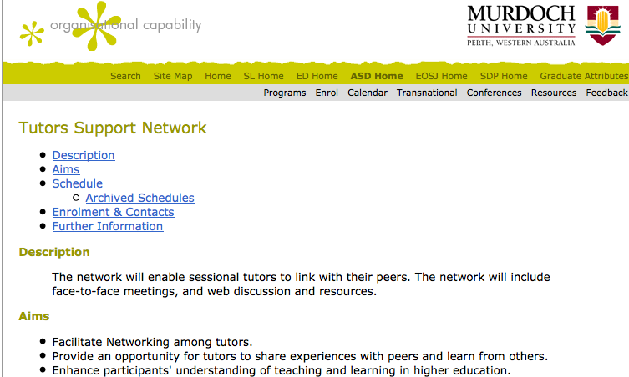
www.tlc.murdoch.edu.au/asd/docs/tutorssupportnetwork.html

Slide 76
Tutor Networks
OU Tutors Learning
  Social bookmarking (subject, ratings)
“designed short teaching scenarios embedding the use of social bookmarking and generated resources to guide other tutors on how to make effective use of RSS feeds for their own updating and knowledge management”
SOCIAL NETWORKING FOR PRACTICE LEARNING
Mary Thorpe
The Open University, United Kingdom

Slide 77

Tutor Networks

Slide 78
Conclusion
Behavioural/Cognitive models at economic and pedagogical dead end
Constructivist models seem, OK for cohort groups- grad studies
Connectivist models and tools are AU’s future
All of us need to develop our personal learning networks

Slide 79
"He who asks a question is a fool for five minutes; he who does not ask a question remains a fool forever.”
Chinese Proverb
Your comments and questions most welcomed!
Terry Anderson terrya@athabascau.ca
http://cde.athabascau.ca/faculty/terrya.php
Blog: terrya.edublogs.org

