Slide 1


Connecting at the Point of Care: Indirect Supervision in Nursing Practice Education
Caroline Park
Jocelyne Van Neste-Kenny
Pamela Burton
Richard Kenny

Slide 2
Nursing Education Practice
Preceptorship
  Shift from preceptorship in final practice courses to across the years of the program
  Need increased number of preceptors because of increased practice settings and “burn out”
Collaborative Learning Unit
Indirect Supervision of students- instructor not present “in real-time” at the point-of care.

Slide 3
Indirect Supervision
Pedagogical concerns
  Preceptors do not have pedagogical background to support all aspects of practice education
Faculty role is to bridge the gap between pedagogy and practice

Slide 4
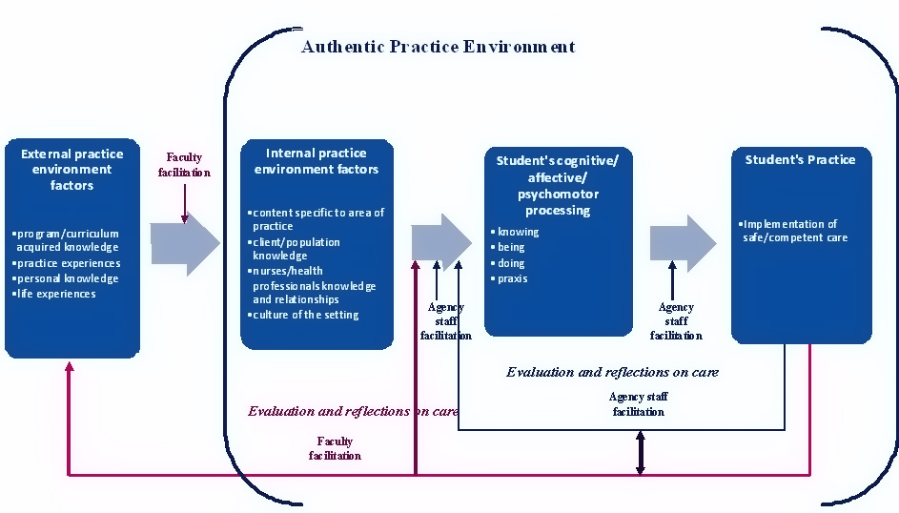
Indirect Supervision Practice Education Model

Slide 5
Potential of Mobile Learning
To support learning that is more situated, experiential and contextualized within specific domains
To support creation and use of more up-to-date and authentic content
(Kukulska-Hulme & Traxler, 2005)

Slide 6
Mobile Enhanced Indirect Supervision Practice Education Model
Vision of faculty involvement at the
point-of-care from a distance
Bringing the instructor back to the
point-of-care in the “just in case, just in time, just enough and just for me”
(Traxler, 2007)

Slide 7
Literature on Mobile Technology in Nursing
Current Uses
  Task lists, memo pads, calculators, expense trackers, calendar/date books, patient manager, practice reference material, address book, information exchange, games, recreational reading, email and Internet (Cahoon, 2002: Rosenthal, 2003 & Stroud et al., 2005)
  Records of student assignments, checklists for completing physical assessments, as a source of point-of-care reference and to document student progress on-the-spot (Lehman, 2003).
Potential
  Interdisciplinary consultations, electronic ordering and test results, patient histories, progress notes and assessments, references, protocols, and prescription information (Newbold,2003)

Slide 8
Literature on Mobile Technology in Nursing
Research on students use
  Significant increase in self-efficacy in preparation for medication administration (Goldsworthy, Lawrence & Goodman, 2006).
  Increased numbers of questions and greater recognition of the need to use current resources ( Miller et al., 2005)
Potential
  Recognized for nursing consultation (Newbold ,2003)
  Instructor-student communication (White et al., 2005).
  The study of connectivity potential of mobile devices is limited

Slide 9
Research Questions
Can the use of mobile devices to connect instructors to students in real-time at the point-of-care be implemented and sustained in indirect supervision models of nursing practice education?
Is the use of mobile devices feasible and practical in nursing practice education settings?

Slide 10
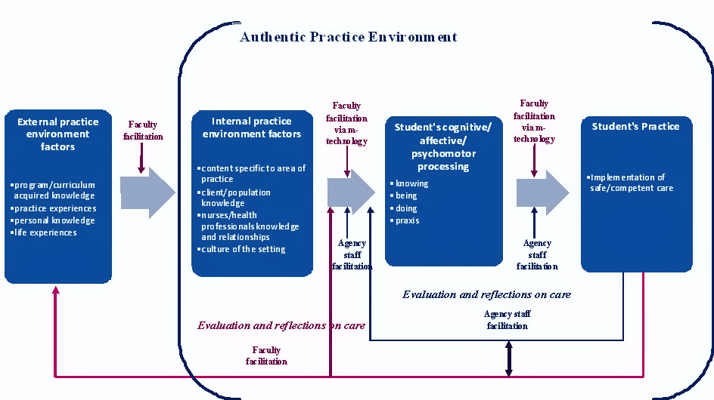
Mobile Enhanced Indirect Supervision Practice Education Model

Slide 11
Methodology
Secondary analysis of semi-structured interviews conducted in two field trials
The first was Stage 2 of a formative evaluation of a 5 week consolidation course
The second was an unpublished study of a 14 week clinical rotation course, with a new 3rd year cohort.

Slide 12
Hardware – Software - Orientation
Device and software applications
  HP iPAQ 6955
  Telephone, camera, WiFi, GPRS, Pocket MS Office, Internet Explorer, MSN Messenger, SKYPE, Acrobat Reader
  Drug guide, lab and diagnostic software
Orientation
  2 hour
  How to use device features

Slide 13
Data Collection and Analysis
Semi-structured interviews with 15 mobile learning group participants and 4 faculty members
Independently transcribed and coded by two research team members, using AtlasTi© software, and then codes were merged

Slide 14
Findings
Using the nursing software
Using the application software
Using the connectivity
  “I was emailing my domains (a class assignment) and what not to [instructor] … they’re similar to journaling. So we’d have to email them straight from our IPAQs, and that’s what I would do. I’d write them up on my IPAQ and email them to her” (S2).

Slide 15
Barriers to Full Exploration
Time to learn and practice
Integration to Practice
Connectivity at the point-of-care
Technical support
Comfort with technology
Device features

Slide 16
Discussion
Seeing the potential
  “I think that this is probably a direction that nursing is gonna go in the future. It’s gonna be a tool and that’s what got my interest. We’re heading towards being more technical out there and for instance as a home care nurse you’re out there and you’ve got a client who’s got a wound and you don’t know what to do. You snap a picture, send it to the physician and get a full colour text message back giving you some directions. So it’s… it has potential to be a great cost saving device as well… in future”. (S6)
Projected uses feasible and realistic

Slide 17
Discussion
Mobile Enhance Indirect Practice Supervision has the potential to
  Enhance pedagogical dialogues at the point of care
  Support agency staff to situate their work with students within their scope of expertise
  Increase student autonomy in their practice
  Create virtual communities of inquiry and practice
Notes:
.

Slide 18
Conclusion
Need to critically examine potential consequences of shifts in health care delivery for practice education
New tools for new challenges
Ensuring that pedagogical requirements drive the use of technology
The “Digital Citizens” are upon us
Use of technology is no longer optional
Use of mobile technologies must be “normalized” into the real world of practice

Slide 19

Questions
Contact Information
  Caroline Parks
    clpark@athabascau.ca
  Jocelyne Van Neste-Kenny
    jvannest@nic.bc.ca
  Pam Burton
  pam.burton@nic.bc.ca
  Rick Kenny
  rickk@athabascau.ca

Slide 20
References
Cahoon, J. (2002, April). Handhelds in healthcare. Advances in Clinical Knowledge Management, 5.Available: http://www.openclinical.org/docs/ext/workshops/ackm5/asbCahoon.pdf
Goldsworthy, S., Lawrence, N., & Goodman, W. (2006). The use of Personal Digital Assistants at the point of care in an undergraduate nursing program [Electronic version]. CIN, 24(3), 138-143.
Kukulska-Hulme, A., & Traxler, J. ( 2005). Mobile learning: A handbook for educators and trainers. London: Routledge.
Lehman, K. (2003). Clinical nursing instructors’ use of handheld computers for student recordkeeping [Electronic version]. Journal of Nursing Education, 42(10), 41-42.
Miller, J., Shaw-Kokot, J. R., Arnold, M. S., Boggin, T., Crowell, K. E.,Allehri, F., et al.(2005). A study of personal digital assistants to enhance undergraduate clinical nursing education. Journal of Nursing Education, 44, 19-26.
Newbold, S. K. (2003, October). New uses for wireless technology. Nursing Management, 22, 22-32.
Rosenthal, K. (2003). “Touch” vs. “tech”: Valuing nursing specific PDA software. Nursing Management, 34(7), 58.
Stroud, S.D., Erkel, E.A., & Smith, C.A. (2005). The use of Personal Digital Assistants by Nurse Practitioner students and faculty [Electronic version]. Journal of the American Academy of Nurse Practitioners, 17(2), 67-75.
Traxler, J. (2007). Defining, discussing and evaluating mobile learning: The moving finger writes and having writ . . . . The International Review of Research in Open and Distance Learning, 8(2). Available: http://www.irrodl.org/index.php/irrodl/article/view/346/882
White, A., Allen, P., Goodwin, L., Breckinridge, D., Dowell, J., & Garvey, R. (2005). Infusing PDA technology into nursing education. Nurse Educator, 30(4), 150-154.

